Slide 1

Data Analytics Capstone Project
By. Ethan Tornga

Slide 2

The Data
MBA Decision Dataset
10,000 Students
19 Columns
Numerical + Categorical Data
Kaggle

Slide 3
Research Question
Domain – Master’s Degree decision making
Specific Problem – What factors have the most influence over a student's decision to pursue an MBA?
Gather insights from research done and potential surveys
This will be helpful for context and validation when presenting

Slide 4
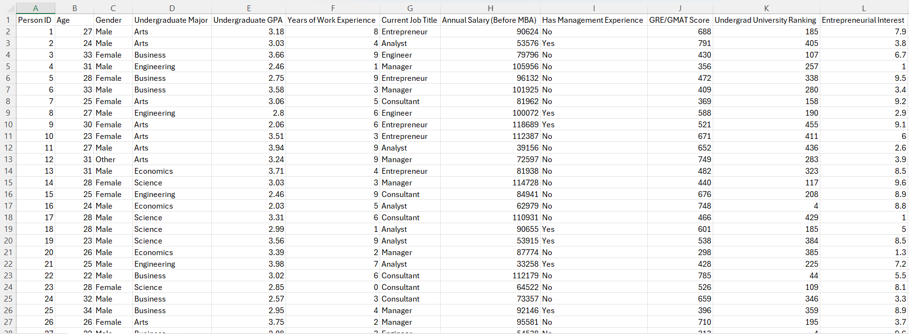
Dataset

Slide 5
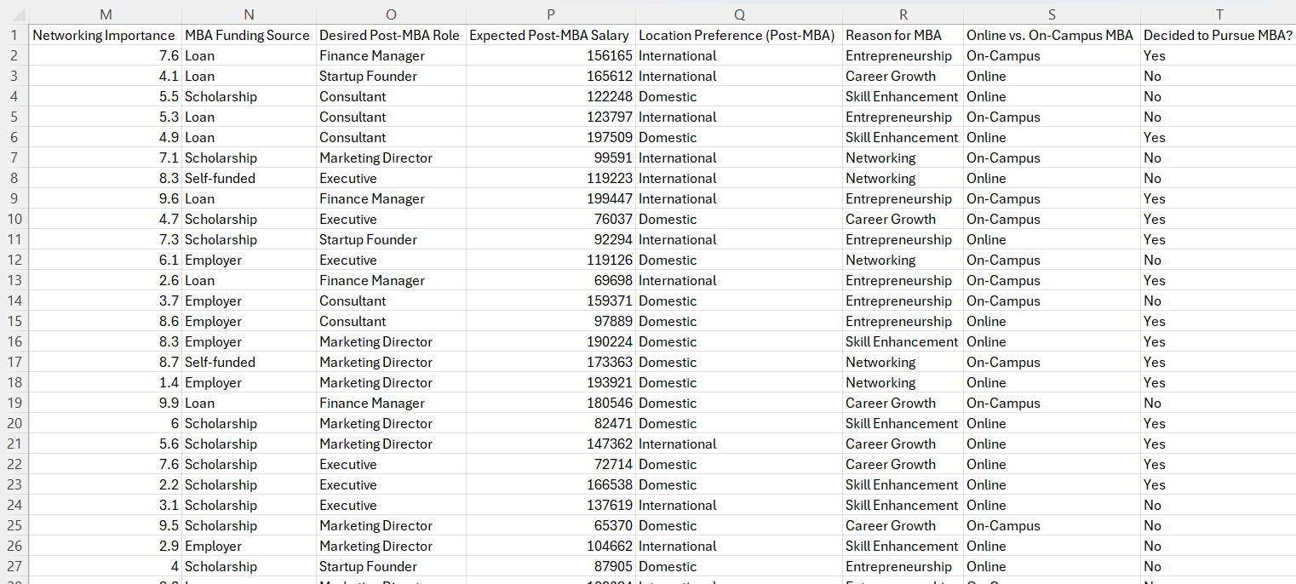
Dataset

Slide 6
SQL Querying
Dropped Entrepreneurial Interest column
Dropped Networking Importance column
Created Salary Difference column
Created Percent of Life Worked column
Create 5 KPIs to help better understand the data

Slide 7
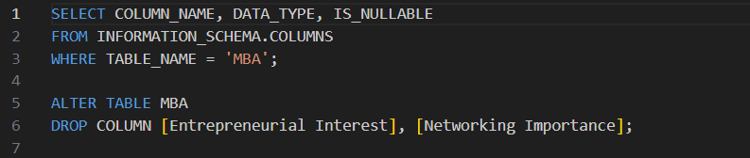
Dropped Columns

Slide 8
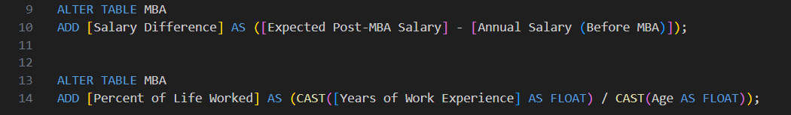
Created Columns

Slide 9
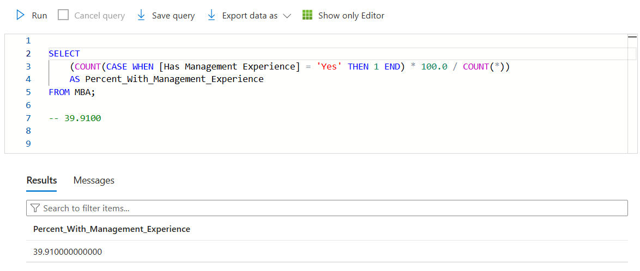
KPIs

Slide 10
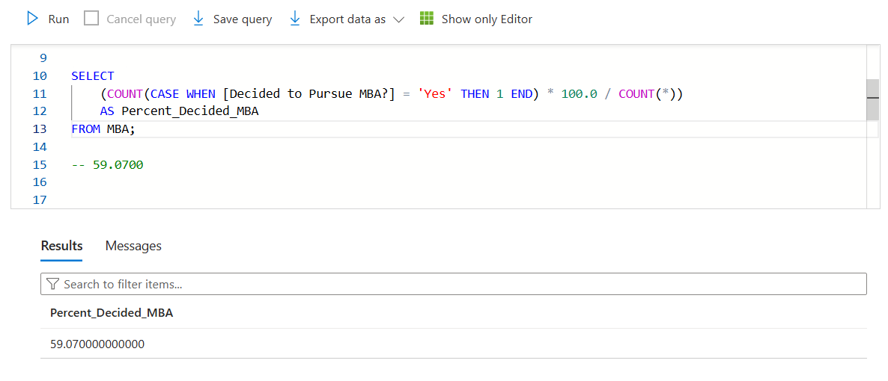
KPIs

Slide 11
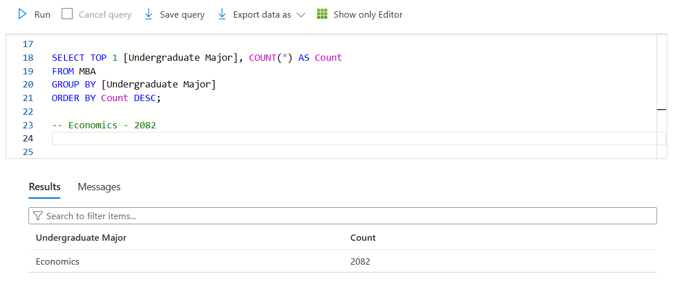
KPIs

Slide 12
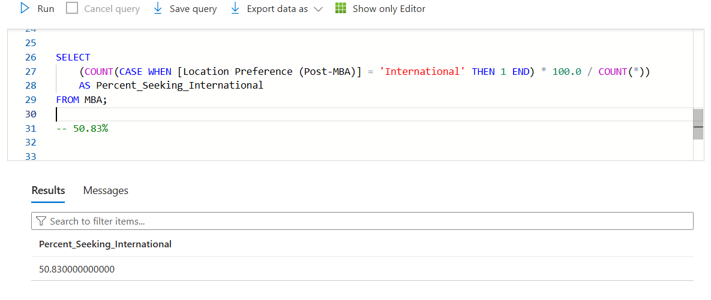
KPIs

Slide 13
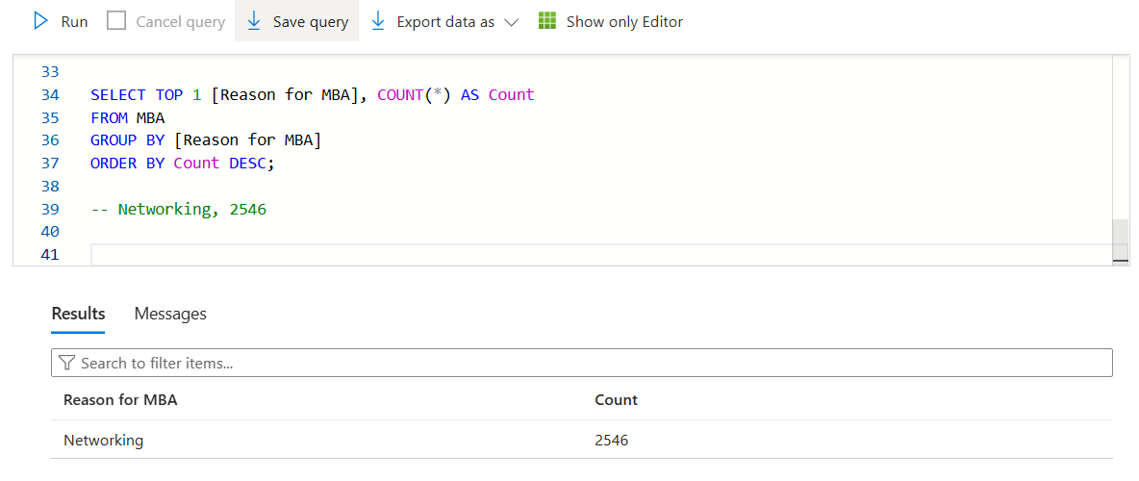
KPIs

Slide 14
Data Management
Cleaning
Checking for outliers, potentially removing columns
1
Wrangling
Deciding what columns to keep/remove/add
2
Preparing
Adding columns
3

Slide 15
Data Management

Slide 16
Python

Slide 17
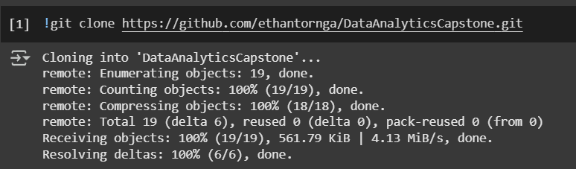
Connection

Slide 18
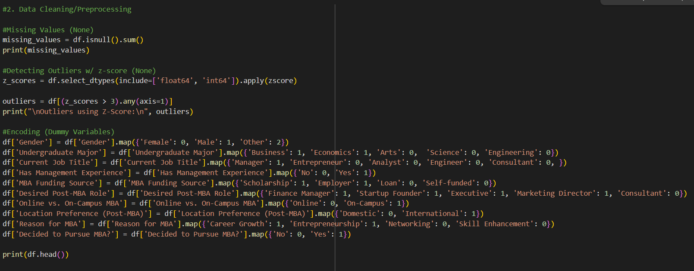
Cleaning and Preprocessing

Slide 19
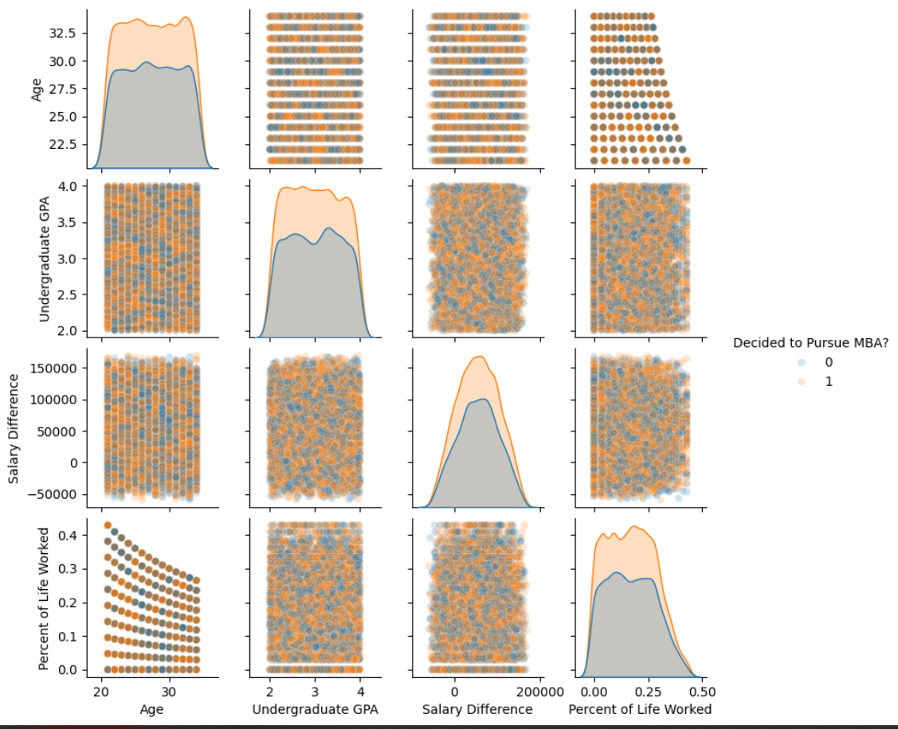
Seaborn Pair Plot for Data Introduction

Slide 20
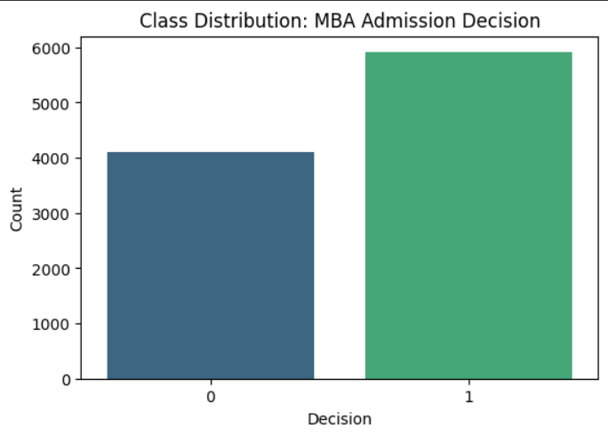
Decision Distribution

Slide 21
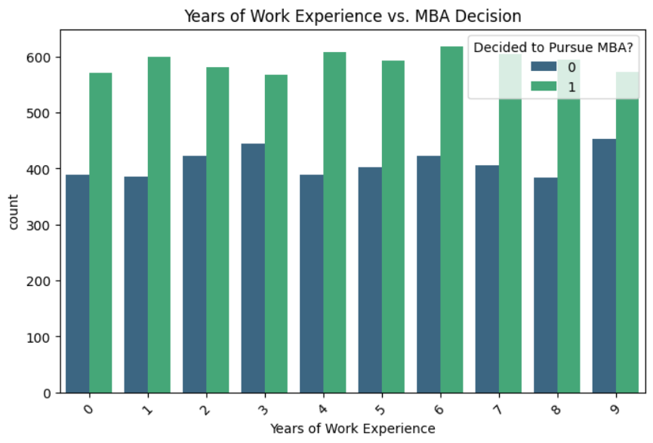
Work Experience vs Decision

Slide 22
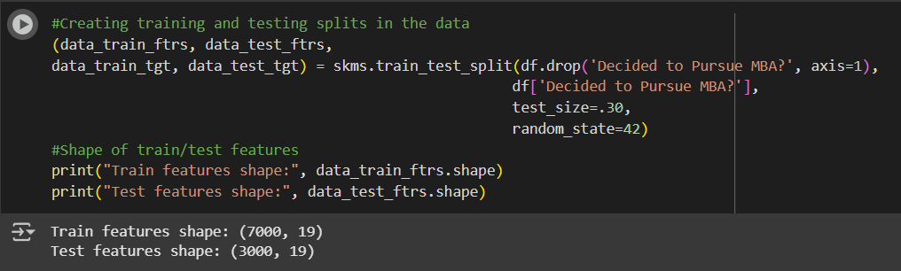
Train / Test Splits

Slide 23
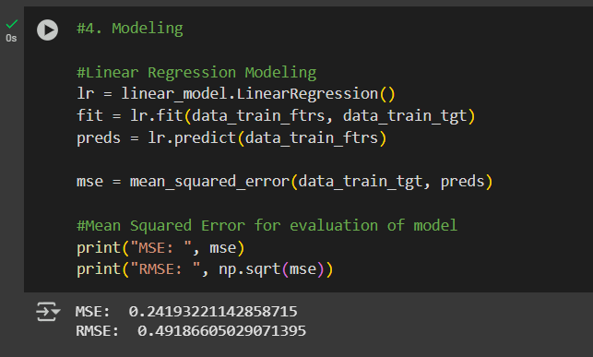
MSE and RMSE

Slide 24
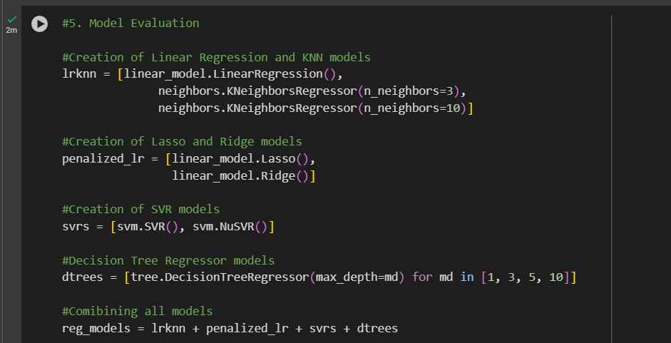
Multiple Model Creation

Slide 25
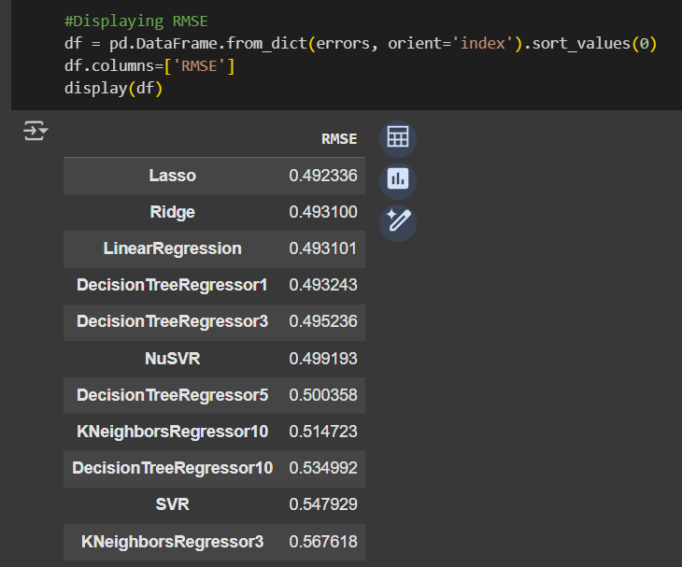
RMSE Results

Slide 26
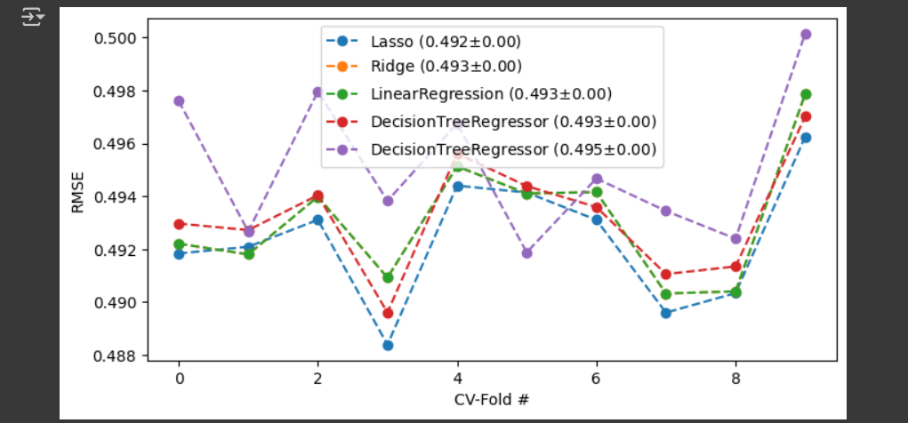
Top Models CV-Fold Graph

Slide 27
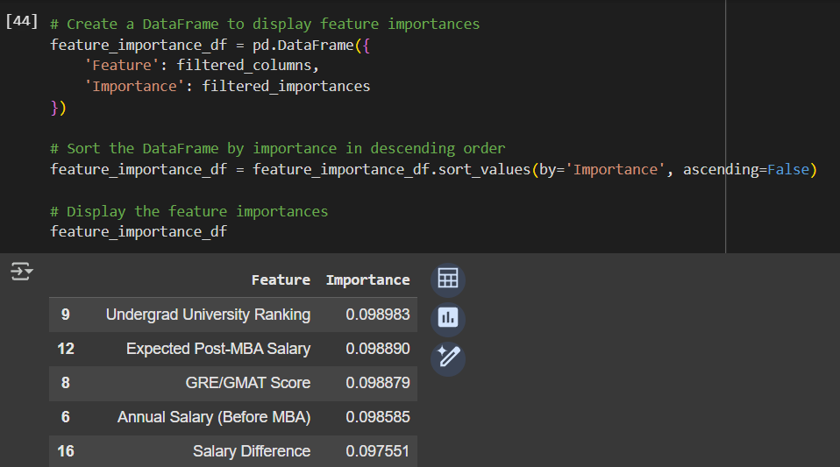
Feature Importance

Slide 28
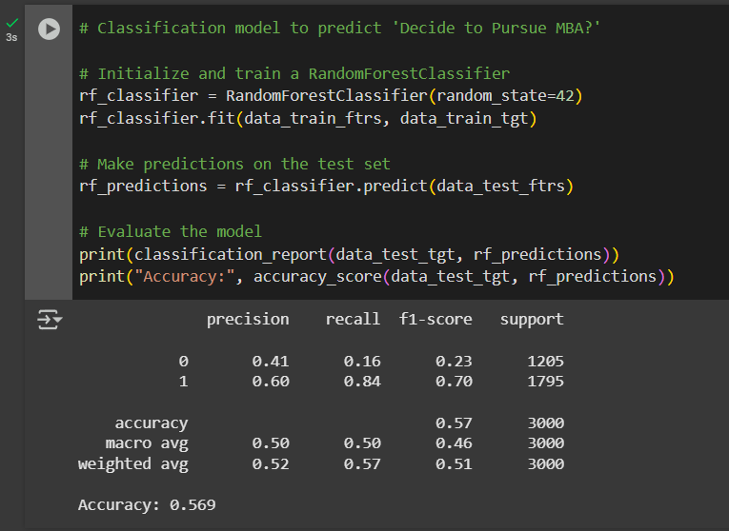
Random Forest Classification Model

Slide 29
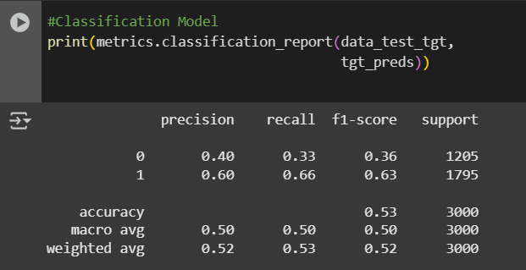
Classification Model

Slide 30
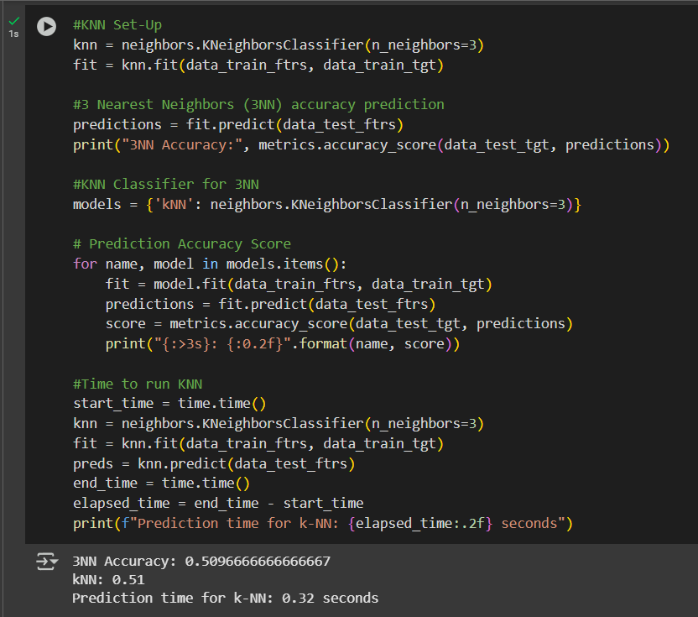
KNN

Slide 31
Visualizations
Power BI
Individual slides for different key metrics
Main interactive dashboard for all key metrics

Slide 32
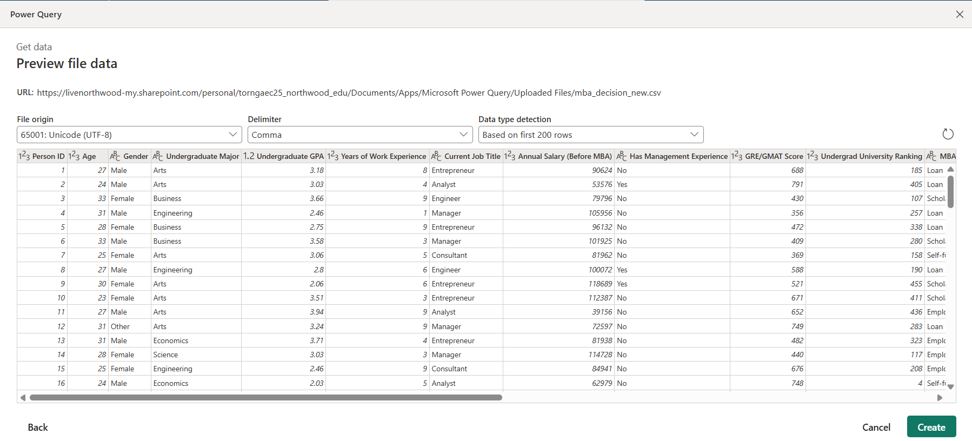
Power Query

Slide 33
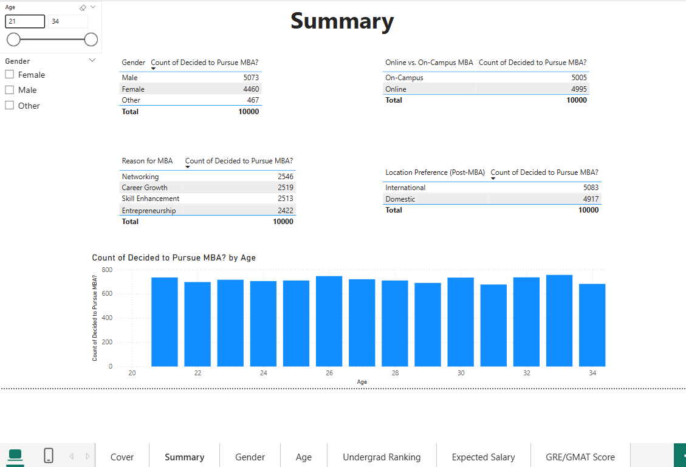
Power BI

Slide 34
Final Analysis
Best Performing Models
Finalize PowerBI Visuals
Add explanations (KPIs) onto slide when needed
Clean up Colab file
Finish report

Slide 35
GitHub Repository

